Slide 1

Ortho eyes
Beau Fiechter Danny Vink Donna van Grunsven Jasmijn Heupers Tim Bekema

Slide 2


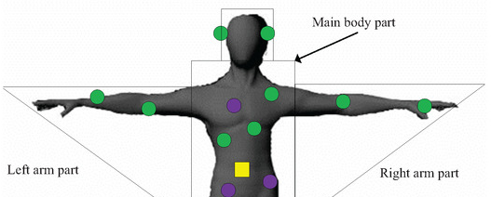
About our project
The goal is to identify the severity of muscle injuries in the shoulder area by video.
We will collaborate with physiotherapy students from Leiden.
There are 4 patient groups in total.
Data collection method: sensory patches are placed on the patient’s body. The patient is then asked to perform four types of movement. This data is stored inside a rotation matrix. Data was collected in different studies, therefore no protocol exists.

Slide 3
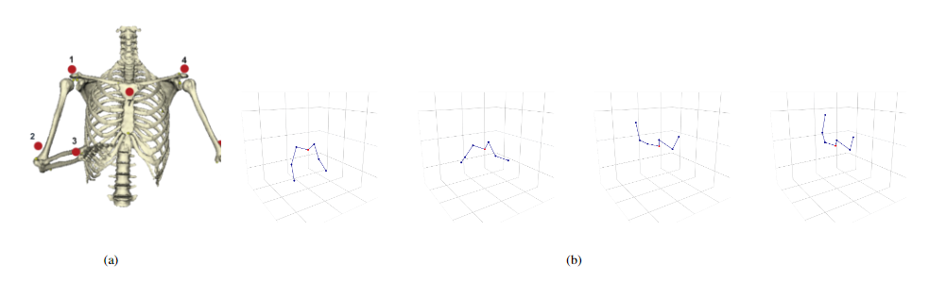
Data collection
Sensory patches location.
Movements are made visible by Python.

Slide 4
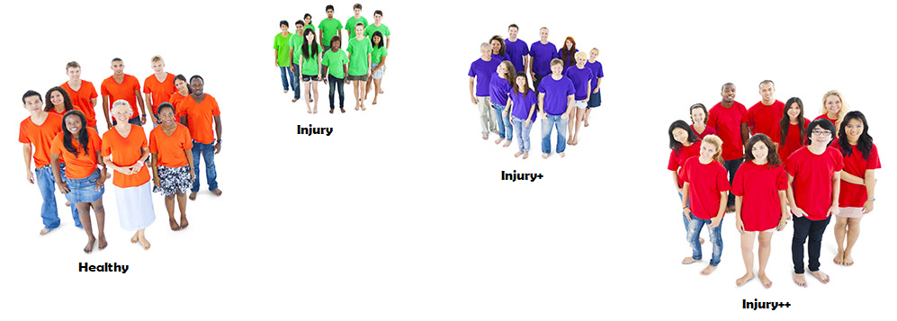
Our goal
Being able to differentiate between all four groups of patients. The previous groups managed to model the computer to differentiate between the control group and group 3.

Slide 5
Possible problems
Our progress and planning
Gathered important intel
DataCamp assignments
Planning meetings with all involved parties (LUMC meeting soon)
Data that was collected is being classified, therefore we don’t know the age/sex/other disabilities of the patient.
A small patient pool but a large data set.

